Slide 1



Hemanand Vadivel
Dhaval Patel
Challenge #8: Provide Insights to the Product Strategy Team in the Banking Domain

Slide 2

Mitron Bank Product Strategy – Codebasics Project
By Shristi Singh

Slide 3
Problem Statement
Mitron Bank is a legacy financial institution headquartered in Hyderabad. They want to introduce a new line of credit cards, aiming to broaden its product offerings and reach in the financial market.
We are acting as Peter Pandey a data analyst at AtliQ Data Services. Our role is to analyse the provided sample data and report key findings to the strategy team of Mitron Bank. This analysis is expected to guide them in tailoring the credit cards to customer needs and market trends.

Slide 4
Demographic classification
1.What most of our customers do?
Salared IT Employee,Other employee and Freelanchers and business owners
2.Age group of most of our customers?
25-34 and 35-45
3.income wise classification
Low income >500000
Middle income <=500000
High income <= 1000000

Slide 5
Avg income utilisation %:
1.Cities with most income utilization%
Mumbai,delhi,bengalurur
2.Income utilization by payment type
Creadit card and UPI
3.Income utilization by occupation
Salaried IT employee and Freelancers may be because the buy business purches like softeware etc with creadit card
4.Age group
35-45 and 25-34
5.Credit card is used for paying for what the most
Bills,groceries and electronics

Slide 6
Spending Insights
1.Month people spend the most?
September,august and October
2.What people prefer to make payment?
Credit card and UPI
3.average spend by customers?
614.46
4.Which gender spends the most?
Male
5.Where people spend most of there money?
Bills,groceries and Electronics
6.Spend by city?
Mumbai,delhi and Bengaluru
7.Spend by occupation?
Salaried IT employee 244M

Slide 7
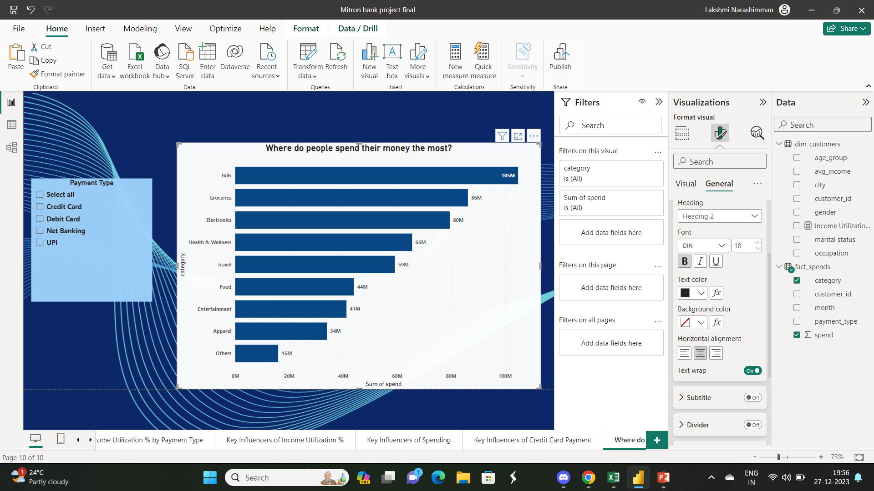
Where do people spend their money the most?
More than 72% of total spending goes to bills, electronics, groceries, health and wellness and travel. It is in these segments people spend more money into

Slide 8
Which employees contribute to major spending?
Salaried employees solely contribute to 55 percent of the total spending. Business owners and the salaried employees contribute to more than 75% of total spending. It is optimal to focus on salaried employees, business owners and freelancers as they contribute to a major chunk of spending. The government employees contribute to least spending when it comes to even the credit card spending.

Slide 9
Who spends more on an average? Men or Women
Women spend lesser than men from this sample dataset of 4000 customers. The average spending of women is 50 to 60 rupees lesser than men.
Which age groups contribute to major spending?
The age groups of 25 to 45 contribute to more than 75% of spending. It is optimal for Mitron bank to focus on credit card marketing schemes towards these ages.

Slide 10
Which city has the highest average spend?
Mumbai, Delhi and Bengaluru has the highest average spend. Their share of average of spending is 70% and contributes to
major chunk of consumer spending among the sample dataset of 4000 customers.

Slide 11
Which occupation has the highest income utilization percentage?
The salaried employees and the freelancers have the highest income utilization percentage. In terms of income utilization, the freelancers have a higher score than the business owners. This is because Freelancers have a greater need to separate their personal and business expenses. And they look out for credit cards that can be used solely for their business purposes

Slide 12
Which category attracts the highest income utilization?
Bills, Groceries, Electronics, health and wellness are the categories that enjoy the highest income utilization above 30.

Slide 13
Which month enjoyed a higher income utilization percentage?
The months August, September and October attracted the highest income utilization percentage as the festival seasons and pre-festival shopping occurs during this time, where customers do their bulk purchases.

Slide 14
Which payment type had the highest income utilization percentage?
Credit card and UPI have the highest income utilization followed by Debit card for these customers. This is because of the increased penetration of UPI apps and credit cards by customers for multiple options like EMI. The usage of debit card is a bit lower as customers in India use debit card when their UPIs don't work. Net banking has the least income utilization percentage as the increased usage of UPI has minimized the usage of internet banking by customers often for the convenience.

Slide 15
Key influence of income utilization
Average of spend is 591.51 then =6.15%
Category is Bills=6.01%
Payment type is credit card= 5.38%
Catgory is Groceries= 3.81%
Key influence of credit card usage
Category is other and food=1.08%
Occupation is salaried emplyee = 1.05%
Category is bill= 1.02%

Slide 16
Credit Card Feature Recommendations
Credit cards in force as of March 2023 were at 8.5 crore, up 15.9 per cent for the year. Total credit card spending in
FY23 was ₹14.3 lakh crore, 47 per cent higher on year, as per the latest RBI data.
Indians tend to be attracted to credit cards that offer lucrative rewards, such as cashback, discounts on dining, travel
perks, and fuel rewards. According to RBI data, reward points played a significant role in increasing credit card usage in
recent years.
Can have special no interest for 30 days on bills payment through credit card during festival season
Provide special premium cards to salaried IT employee and salaried employee with greater sending powers
Freelencers have high income utilization so we can give them special discounts on software they use.
Age group of 24-34 and 35-45 we can give credit rewards as vouchers for groceries,travel and heath and wellness
Heightened security measures like two-factor authentication, fraud alerts, and enhanced encryption are critical. A study
by PwC India highlights that security concerns often deter credit card usage

Slide 17
Credit Card Feature Recommendations
Indians are often sensitive to fees. Credit cards with minimal or waived annual fees tend to attract more users, as report by CRISIL Research.
Educating consumers about the responsible use of credit cards and their benefits can also positively impact usage. Programs and resources that promote financial literacy can encourage more individuals to use credit cards.

Slide 18
Thank you

